Slide 1
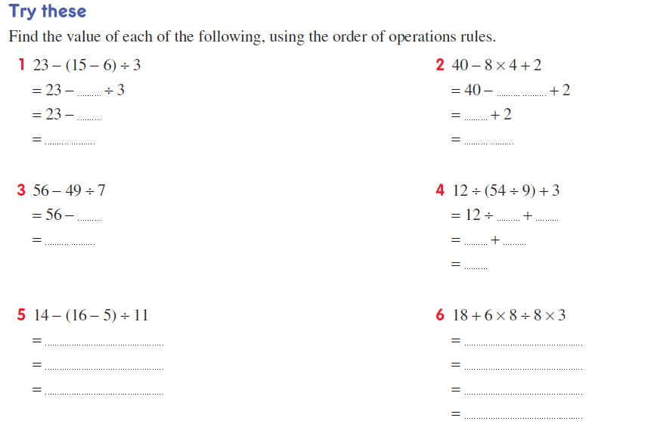
Mental maths
9
32
3
8
20
10
7
6
3
49
2
3
5
13
36

Slide 2
Silent card shuffle
In groups of 4
Each group should have
- 1 A3 page with a table on it
- 20 cards (5 each)
Notes:
Hook
Each group should have cards as well as a sheet to glue them onto

Slide 3
Rules
You may only touch your 5 cards when I say
You can only touch your own 5 cards!
You cannot talk to each other
Don’t be afraid to make mistakes

Slide 4

Start
(you have 3 mins)
Stay silent!!!

Slide 5
Lets check
(You have 1 minute)
Discuss with your group
Make some changes if you think you need to

Slide 6
Gallery Walk
Walk around the room in a clock wise direction and have a look at what other groups have done.

Slide 7
Make some final changes
Is your group’s correct?
Do you need to make some changes?
Be prepared to share you group’s response

Slide 8

Are you ready for the answer reveal?

Slide 9
Answers
+ | - | x | ÷
Add Sum Increased by Total plus | Decreased by Difference Less than Subtract Take away | By (dimensions) Double Product Times multiply | Halve Quotient Divide Share split
Take a photo of the correct answers (This can go in your glossary)
Notes:
Make sure each student gets a copy of this. Would definitely be good for their glossaries
Get students to glue the cards in the correct places (you now have some posters for your room)

Slide 10
Lesson objective
By the end of this lesson you will be able to;
- Turn sentences into algebraic expressions
Notes:
Lesson

Slide 11
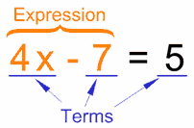

24
7
30
Date
Algebra
EQ –how do we write algebraic expressions?
An expression is a group of terms
(the terms are separated by + or – signs)
What is an expression?
What are the numbers?
What are you being asked to do
Write the expression
Writing an expression
Example:
a) the sum of three and four
How do we write an expression from a sentence?
3 4
$$+$$
5
Notes:
Input

Slide 12

What are the numbers?
What are you being asked to do
Write the expression
Try these
Write an expression for these;
The sum of six and seven
the product of nine and three
The difference between twenty and thirteen
The sum of six and nine is shared between three
Notes:
Check for understanding

Slide 13

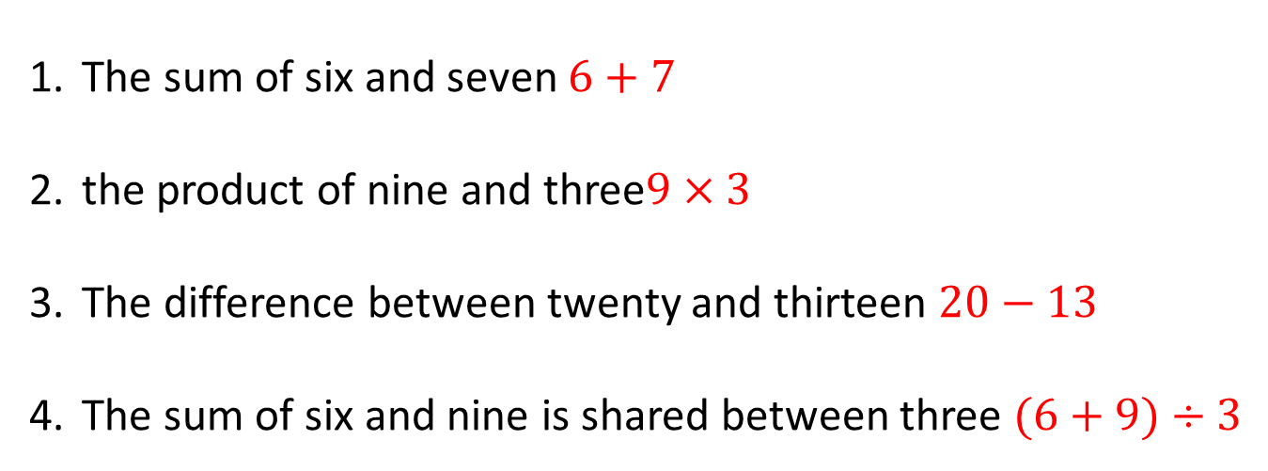
What are the numbers?
What are you being asked to do
Write the expression
Answers
The sum of six and seven $6+7$
the product of nine and three$9×3$
The difference between twenty and thirteen $20−13$
The sum of six and nine is shared between three $(6+9)÷3$
Notes:
Check for understanding

Slide 14

Activity
Page 90 exercise 7.3
Notes:
Independent practice

Slide 15

Lets make sentences
Turn these into a sentences
Eg. 3+4 three is increased by four
$5×2$
$6−9$
$3×4+12$
Notes:
Closure

